Slide 1
What Does it take to be Different?
The BAP Brand
Andrew W. Argue
The University of Tampa

Slide 2
How do you “sell” your Chapter?

Slide 3
Our Brand Brand Development The Results

Slide 4
Personal and Professional Development of the Individual
Notes:
The first thing my executive committee and I did was develop the idea and this idea is what I am going to encourage you to all take home today. We believe that job opportunities and networking were the most important factors in marketing BAP, but we believe this was an effect of something greater. It was an effect of the power, impact, and grandiosity of each individual member.
So we decided to focus not on the networking, job, service, or anything else. We invest more time into the individuals ability to look within themselves, introspect, think about why they do what they do.
We committed ourselves to the personal and professional development of the individual members of our chapter, personal coming first. We want them to learn about themselves and how they interact with others, the human connection they form, in order to move forward in the organization and in their career.
We….. at the time believe that if we focused on this, relentlessly… The networking, jobs, opportunities etc. would all follow.

Slide 5
Brand Development
Intramurals
Impactful Videos
Resume workshops w/ members
Coaching Program
Members
Professionals (tangent)
Recognition
Snuggies
Icebreakers
TeamBuilders
Diversity Month
Scholarship Competition

Slide 6
Brand Development
Best Practices
2 teams
13 people Presenting
1st & 2nd Place at Nationals
Leadership Retreat
Overnight
Camping
26 members
Laughter and crying
~$20,000 on the members

Slide 7
Leadership Retreat
Saturday
9:00am Depart
10:00am Arrive at Cedarkirk
11:00am Lunch
12:00pm - 3:30pm Ropes course from
3:30pm – 7:00pm Afternoon Activities
7:00pm – 8:00pm Dinner
8:00pm – Games & Activities
Sunday
8:00am Wake-up
9:00am - 10:00am Breakfast
10:30am return home
11:30am arrive on campus - Enjoy

Slide 8
Step into the Circle
You consider yourself a Democrat
You consider yourself a Republican
You consider yourself a socialist
You consider yourself a feminist
Your parents have either divorced, separated, or never married
You come from a family of four or more children
You are an only child
You live independently of your parents
You have taken primary responsibility either for raising another member of your family
You have been to graduate school or plan to attend graduate school
You are scared about life after college

Slide 9
Step into the Circle
You have a medical problem
You have a learning disability
You have a physical disability
You have questioned your sexual orientation
You are gay or lesbian
You are bi-sexual or transgender
You have experienced the effects of alcoholism in your family
You have experienced the effects of drug addiction in your family
You have experienced suicidal thoughts at some point in your life
You have cried at least once this year

Slide 10
The Results

Slide 11
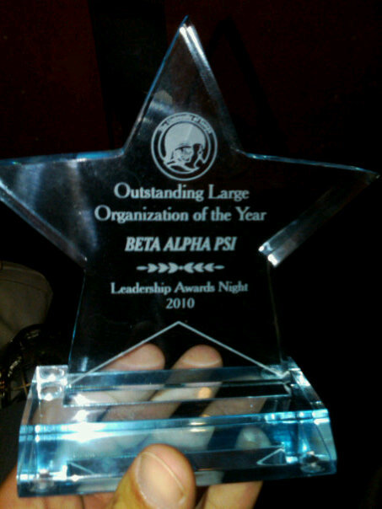
The Results

Slide 12
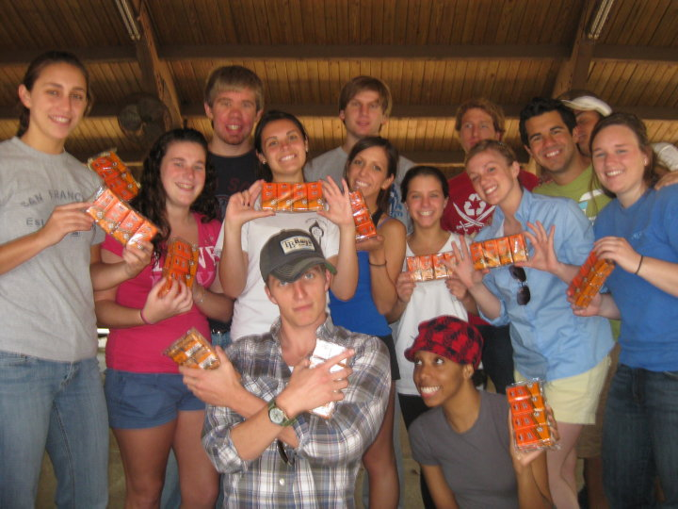
The Results

Slide 13
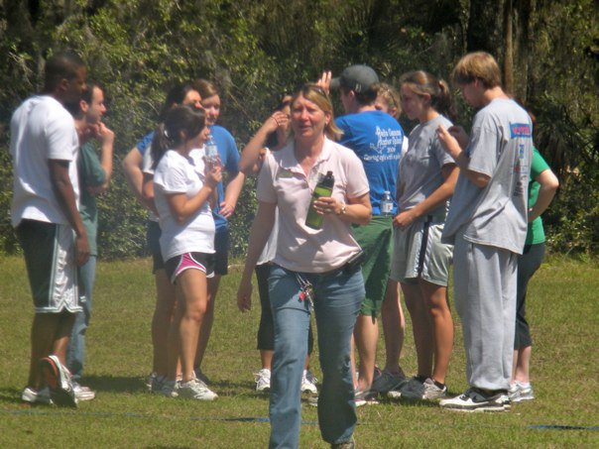
The Results

Slide 14
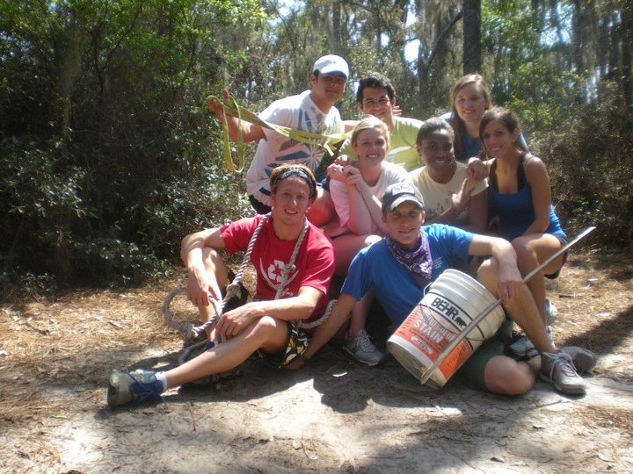
The Results

Slide 15
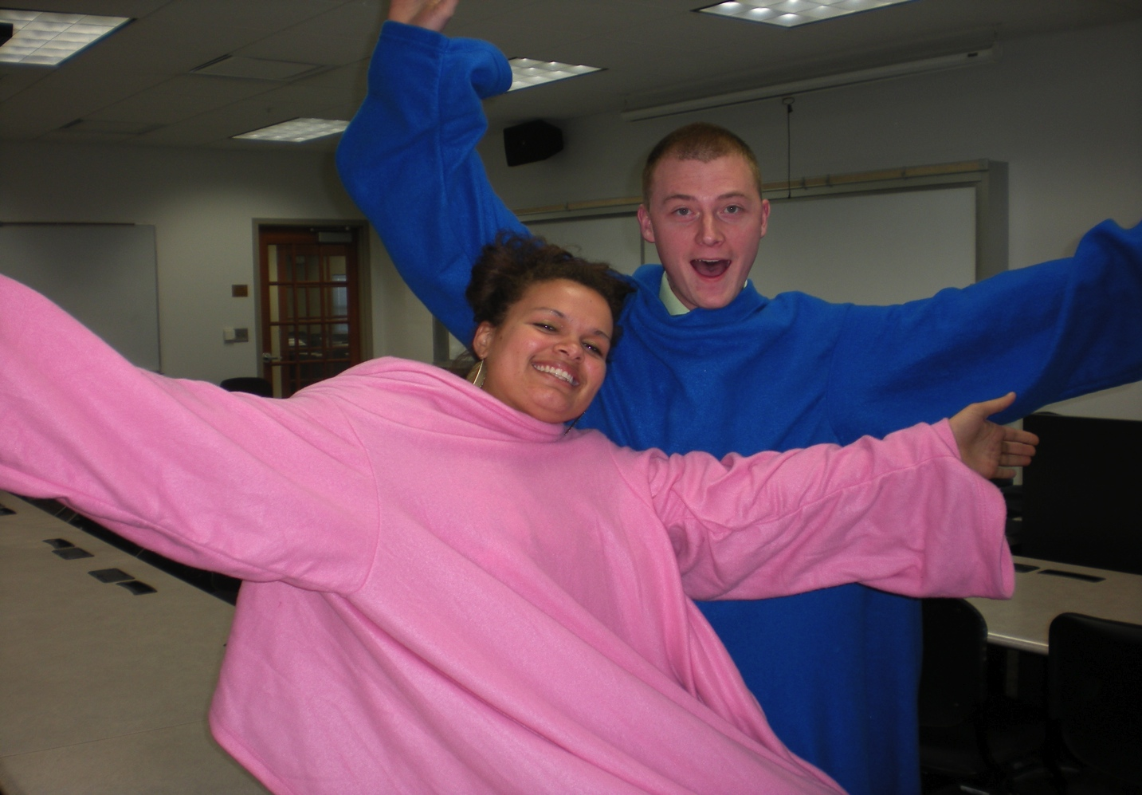
The Results

Slide 16
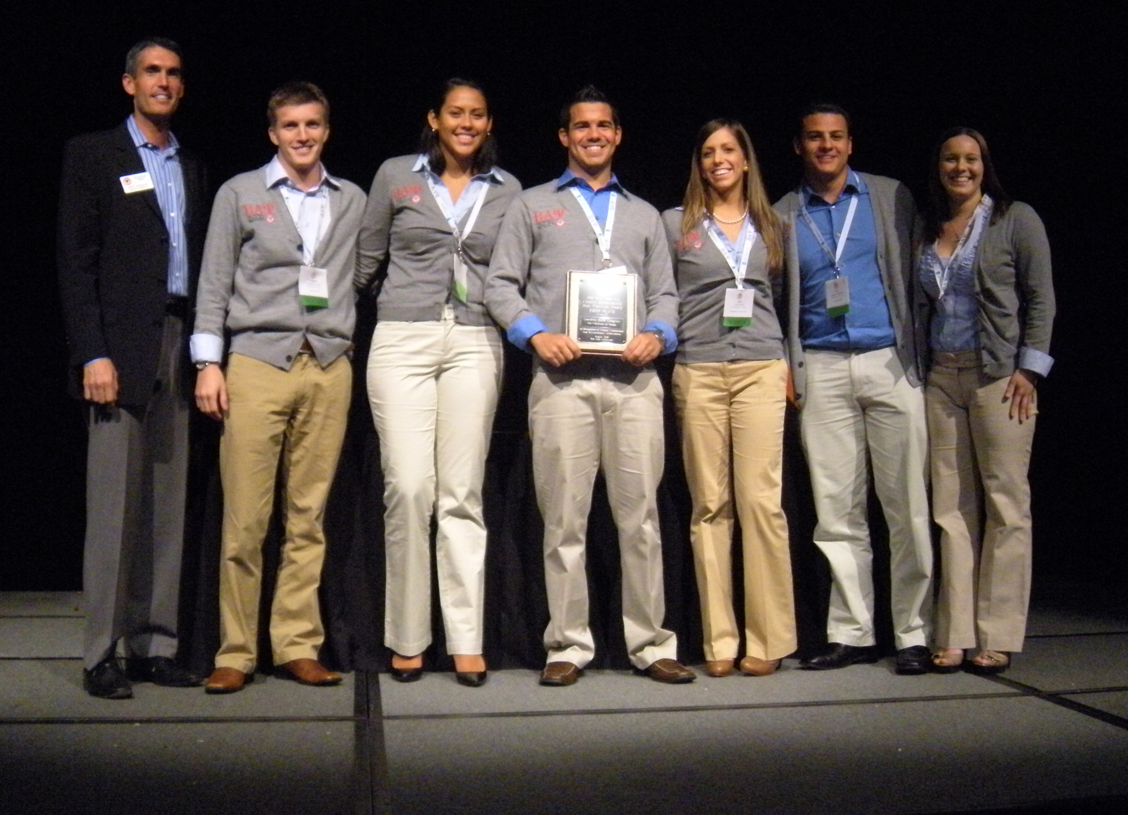
The Results

Slide 17
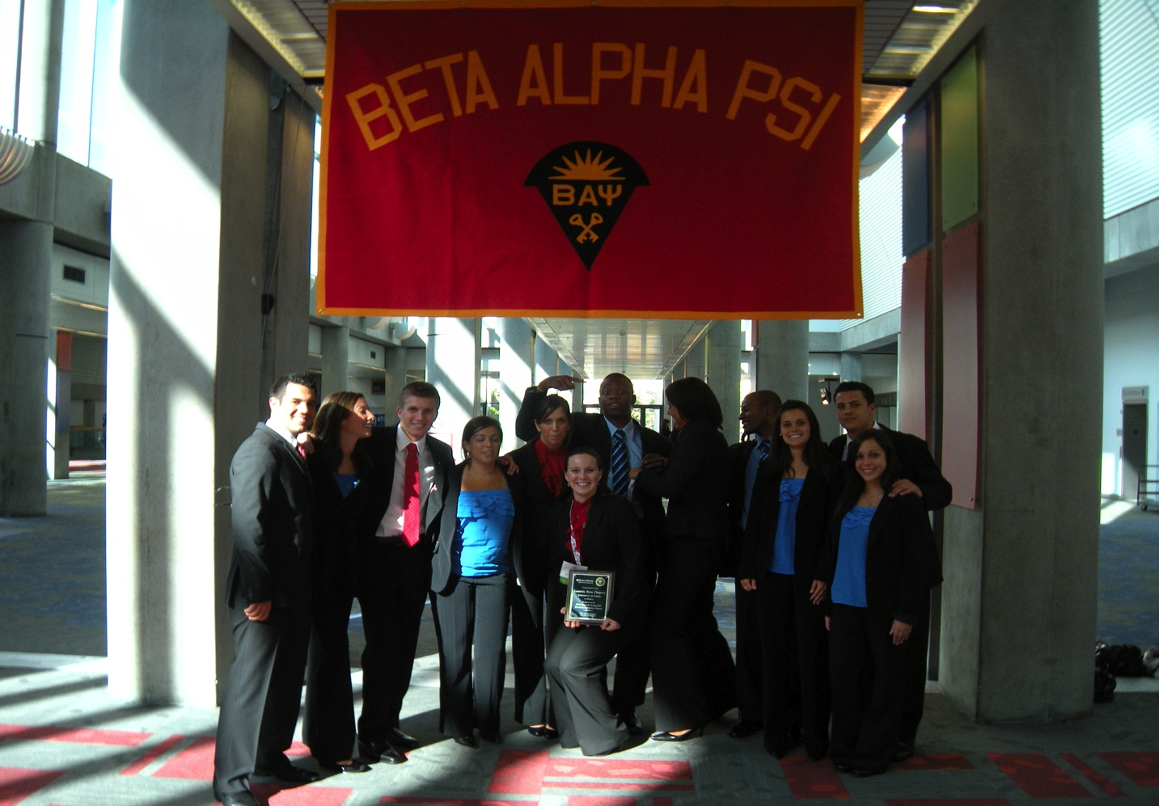
The Results

Slide 18
The Results

Slide 19
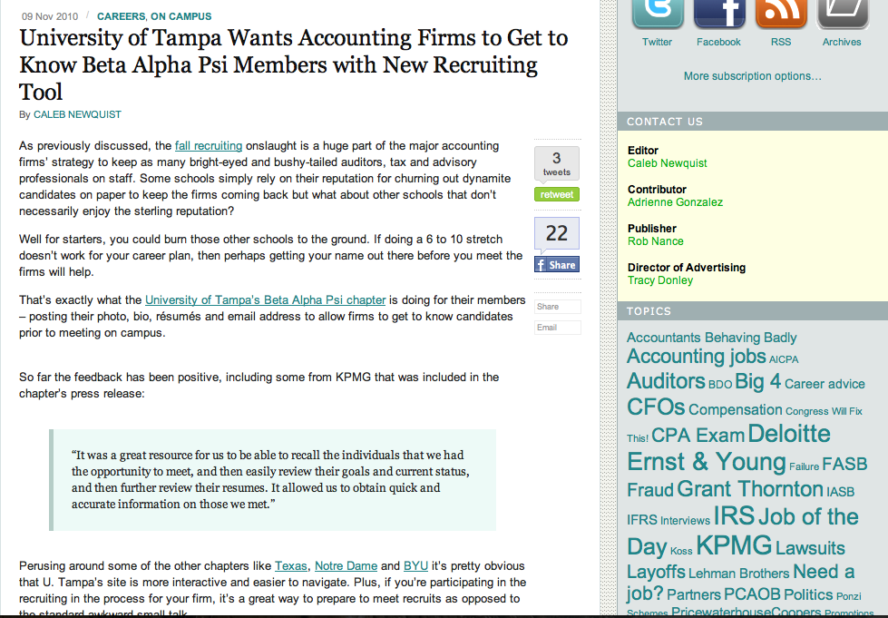
The Results

Slide 20
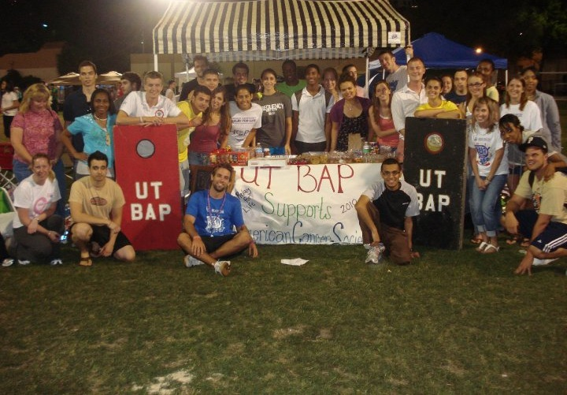
The Results

Slide 21
Our Brand Brand Development The Results

Slide 22
Speakers
Community Service
Hours
Budget
Tutoring
Professional Hours
Meeting Attendance
E-mails
Etc………..

Slide 23
Personal and Professional Development of the Individual
Notes:
The first thing my executive committee and I did was develop the idea and this idea is what I am going to encourage you to all take home today. We believe that job opportunities and networking were the most important factors in marketing BAP, but we believe this was an effect of something greater. It was an effect of the power, impact, and grandiosity of each individual member.
So we decided to focus not on the networking, job, service, or anything else. We invest more time into the individuals ability to look within themselves, introspect, think about why they do what they do.
We committed ourselves to the personal and professional development of the individual members of our chapter, personal coming first. We want them to learn about themselves and how they interact with others, the human connection they form, in order to move forward in the organization and in their career.
We….. at the time believe that if we focused on this, relentlessly… The networking, jobs, opportunities etc. would all follow.

Slide 24
Andrew@TheBAPBlog.com

Slide 25
Conference Agendas
Org. of the Year
Ten Year Plan
Logos
Diversity Award
Step in the Circle
Video
LC Agenda
Press Release Template
Interest Meeting Slides
Notes:
The first thing my executive committee and I did was develop the idea and this idea is what I am going to encourage you to all take home today. We believe that job opportunities and networking were the most important factors in marketing BAP, but we believe this was an effect of something greater. It was an effect of the power, impact, and grandiosity of each individual member.
So we decided to focus not on the networking, job, service, or anything else. We invest more time into the individuals ability to look within themselves, introspect, think about why they do what they do.
We committed ourselves to the personal and professional development of the individual members of our chapter, personal coming first. We want them to learn about themselves and how they interact with others, the human connection they form, in order to move forward in the organization and in their career.
We….. at the time believe that if we focused on this, relentlessly… The networking, jobs, opportunities etc. would all follow.

